Slide 1
Results from Nextef
Observations in high gradient tests of
CLIC Prototype Structures and associated study activities
CLIC2013, CERN
29 January, 2013
T. Higo (KEK)

Slide 2
Contents
Summary on CLIC prototypes
  The most recent result on TD24R05
  Comparison
    Ramping speeds
    Breakdown rates
  Hot spots
Further studies in Nextef

Slide 3
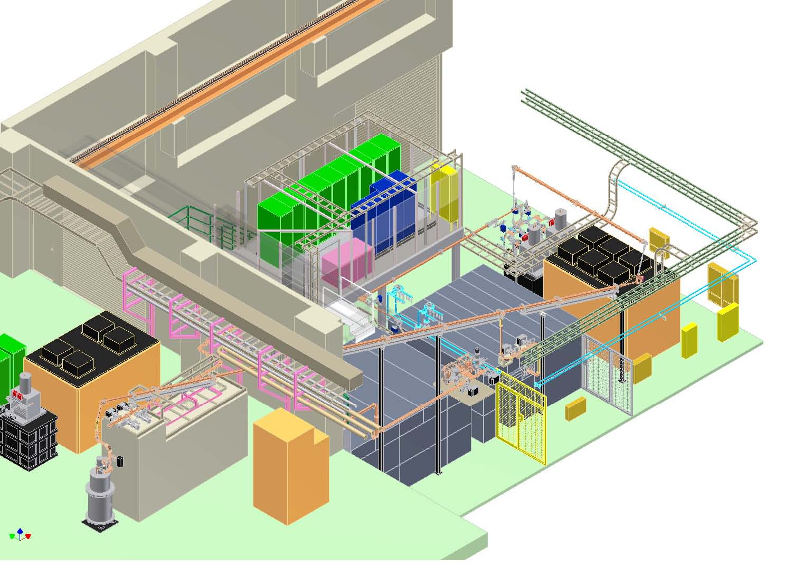
Nextef for high gradient R&D
Nextef Control
Nextef
X-band
KT-1
X-band
B
KT1-B
A
KT-2
C-band

Slide 4
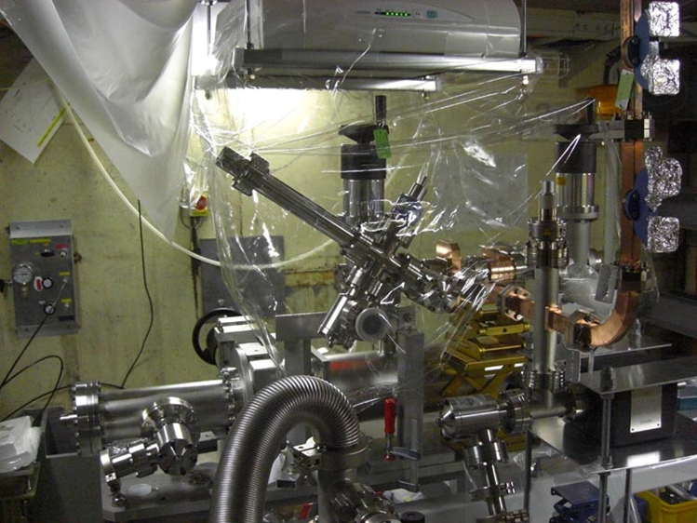
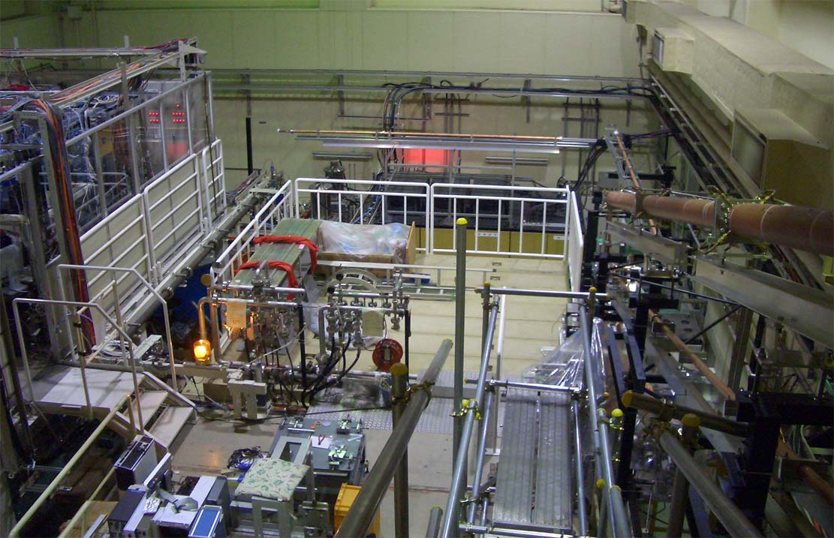
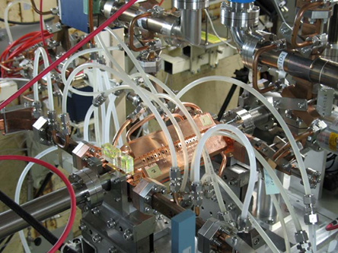
Nextef
RF source for A
Control
Shield B
B
A
Shield A

Slide 5
High gradient tests of
CLIC prototype structures
Collaboration from 2007 ---
→ T18#2 2008 --- 2009
→ TD18#2 2009 --- 2010
→ T24#3 2010 --- 2011 IWLC2011 Granada
→ TD24#4 2011 --- 2012 LWLC2012 Arlington
→TD24R05#2 2012 --- 2013 CLIC2012 Geneva
→TD24R05#4 2013 ---

Slide 6
High-gradient test at Nextef
2008 2009 2010 2011 2012 2013
4 7 10 1 4 7 10 1 4 7 10 1 4 7 10 1 4 7 10 1 4 7 10 1
GLC
CLIC prototype tests
KX03 (60cm HDDS)
1
T18_Disk_#2
1.5
TD18_Quad_#5
Nextef
2
TD18_Disk_#2
3
T24_Disk_#3
4
TD24_Disk_#4
5
TD24R05 #2
Narrow waveguide test
TD24R05 #4?
High power components test
TD24R05(KEK)?
KT1
KT1 to shield-B
Replace klystron
Basic studies at shield-B
Shield-B

Slide 7
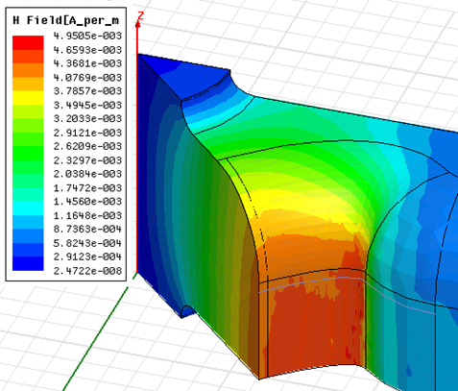
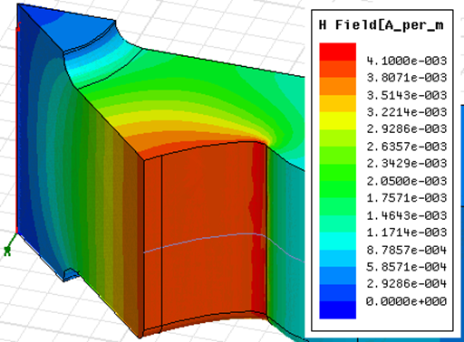
Reduce Hp/Ea and DT by reducing corner radius in the cell
Alexej Grudiev
TD24
TD24R05

Slide 8
What to be studied in mind with the most recent test with TD24R05
Prove the CLIC high gradient feasibility
Undamped → well done in T24
Prove with damped structure
Ramping speed
BDR at 100 MV/m
Evolution of BDR vs time
BDR vs Eacc
BDR vs width
Robustness against long-term operation

Slide 9
Preparation always follow our nominal structure fabrication flow

Slide 10
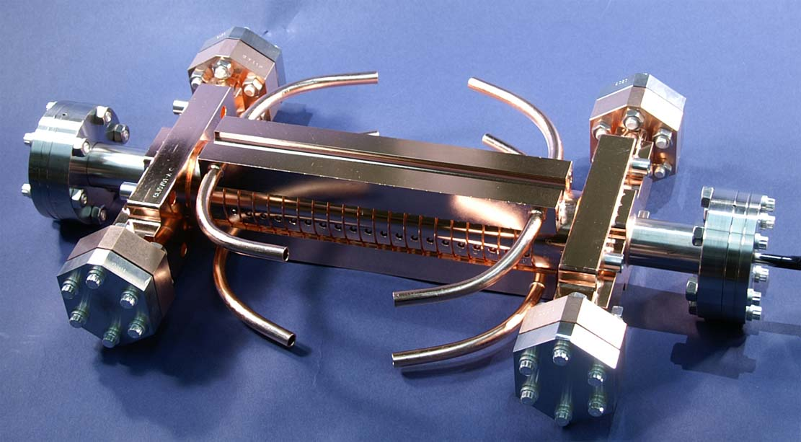
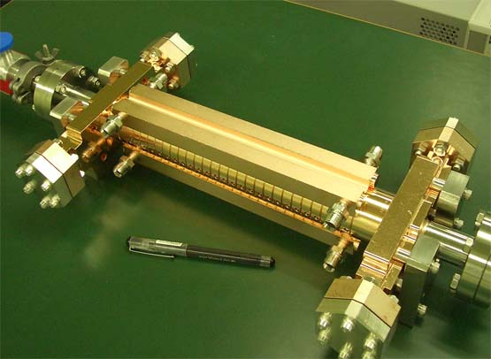


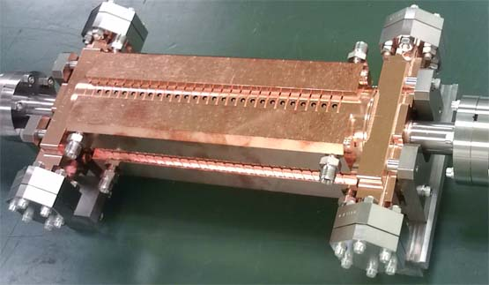
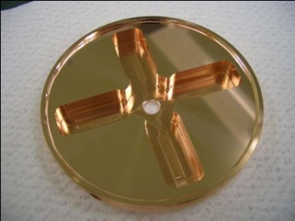
CLIC test structures; fabrication and test
T18 →TD18→T24→TD24→TD24R05
1. T18_Disk_#2
undamped
3. T24_Disk_#3
damped
2. TD18_Disk_#2
4. TD24_Disk_#4
5. TD24R05 under test now

Slide 11
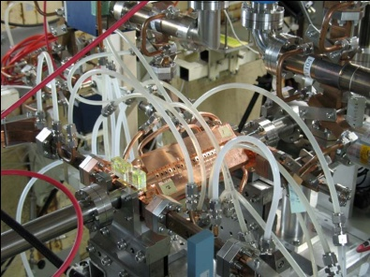
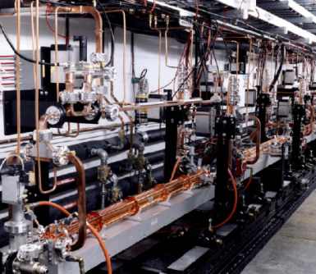

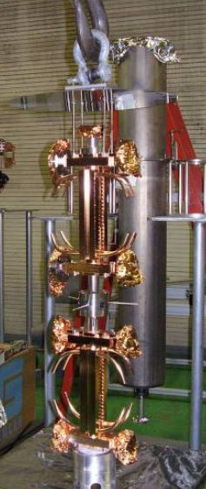
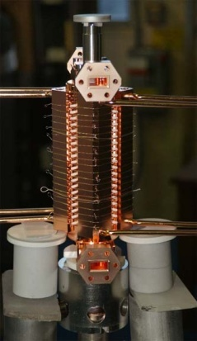
SLAC/KEK typical fab/test flow
Design for CLIC (CERN)
High power test (NLCTA-SLAC)
High power test (Nextef-KEK)
Fabrication of parts (KEK)
CP (SLAC)
VAC bake (SLAC)
Bonding (SLAC)
Notes:
プロトタイプの試験サイクル
ここでも 日米を基礎におく SLAC・KEK キープレーヤー

Slide 12
TD24R05 and Comparison in initial processing

Slide 13
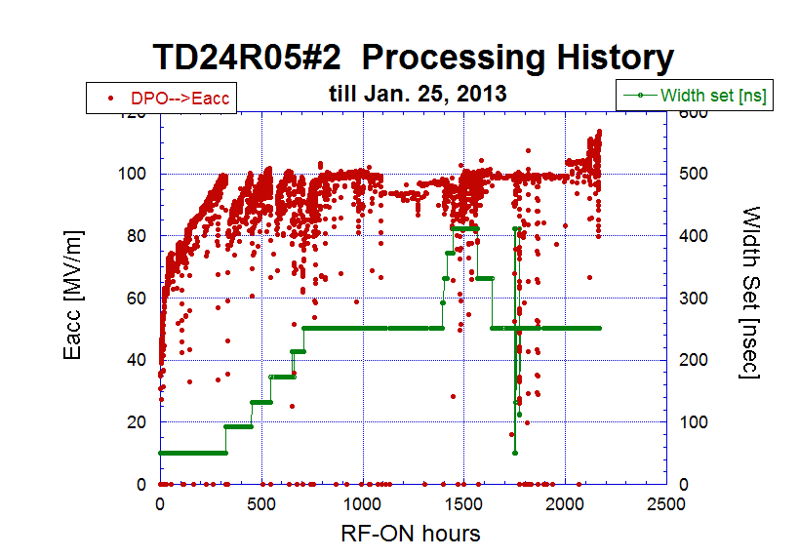
TD24R05#2 Processing history

Slide 14
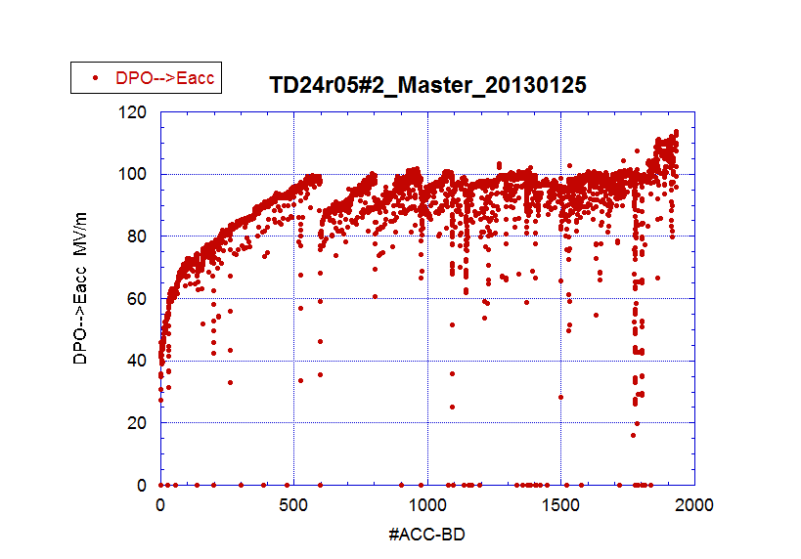
TD24R05 Eacc versus #ACC-BD

Slide 15
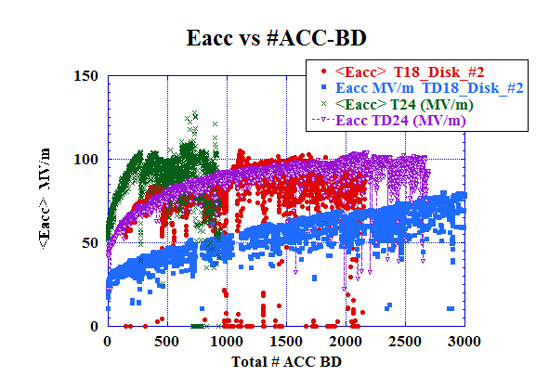
Difference in processing speed among
5 disk-stack-type CLIC-prototype structures
Number if ACC-BD’s until reaching the same level in (Tp, Eacc)
Speed
→1. T24
→ 2. TD24R05
→ 3. T18
→ 4. TD24
→ 5. TD18
TD24R05
T24
T18
91ns
132ns
51ns
TD24
TD18
Still to be revised for better comparison (130126)

Slide 16
Breakdown rate in flat pulse operation

Slide 17
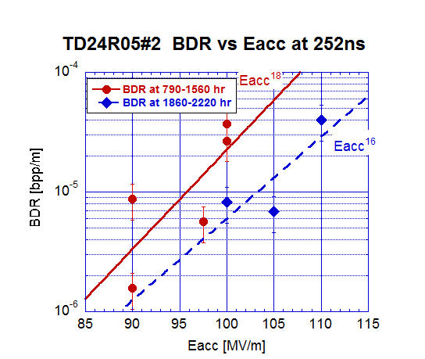
TD24R05 less steep as Eacc than TD24.
To be evaluated in a better experimental situation and possibly at later times.

Slide 18
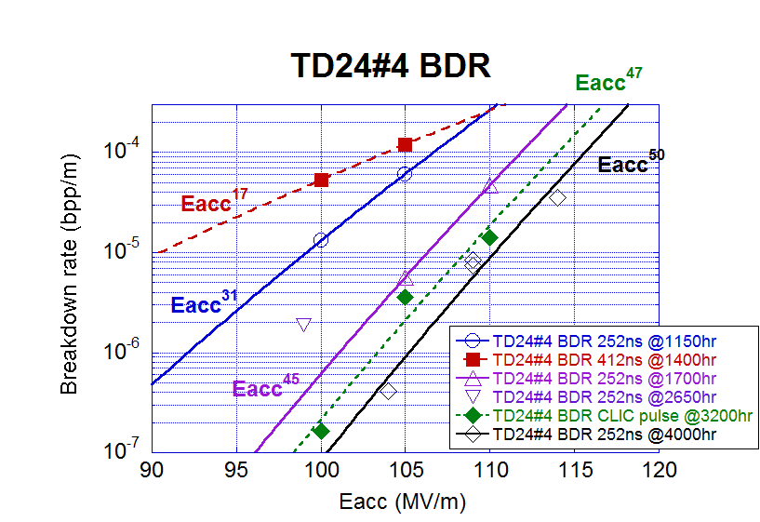
BDR summary on TD24
comparing to T24
Arlington presentation
+ typical present
TD24#4
(~2000hrs)
T24#4
(final)

Slide 19
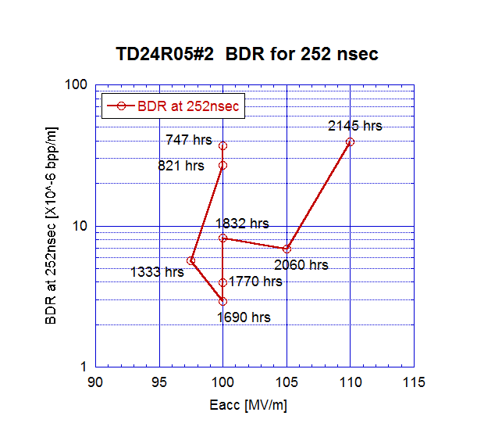
Similar to TD24 but deteriorated at 1700hrs during long-pulse?
Run 31
Run 29

Slide 20
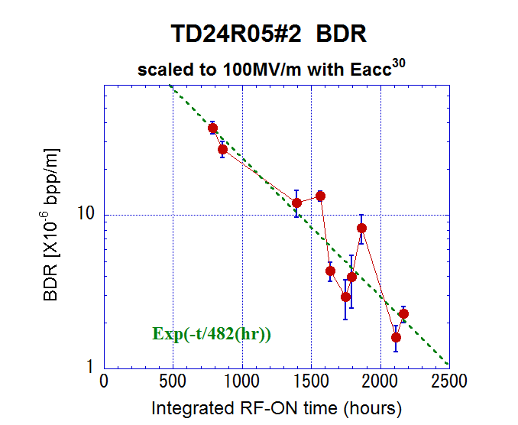

Slide 21
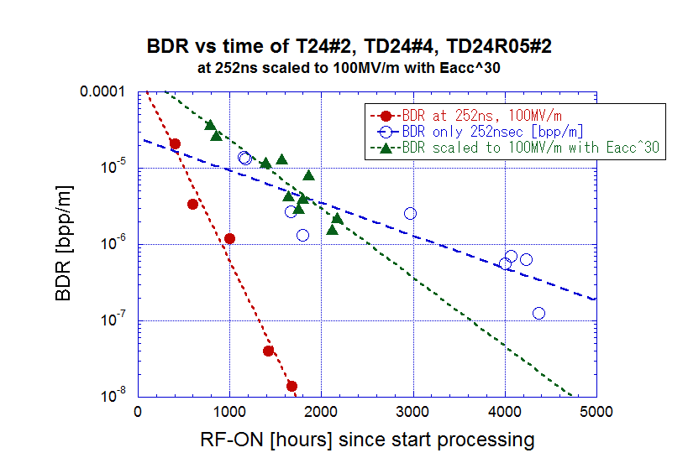
The same as TD24 in the early stage with hot spots appeared.
Curious to see how it goes eventually.

Slide 22
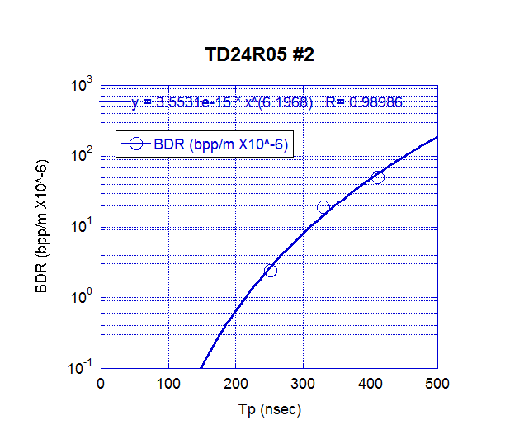
BDS vs width
Typical and similar to those before.
Worthwhile to compare among those carefully but this work is underway.
Longer pulse may make the situation bad, as seen in TD24R05.
Width dependence measured
At time from RF-ON about 1600 hours

Slide 23
Appearance and disappearance of hot spots

Slide 24
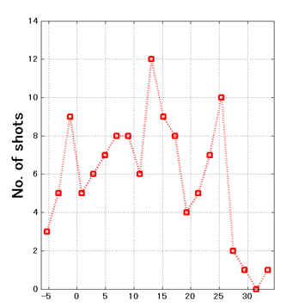
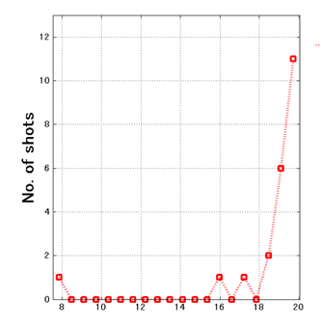
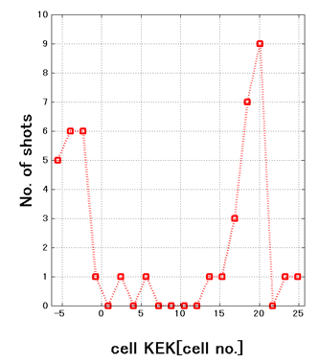
Hot spots have appeared
Run 11
706—787 hrs
Run 31
2122—2169 hrs
Run 27
1797—1863 hrs
BD cell
No bad cell
Downstream
Upstream

Slide 25
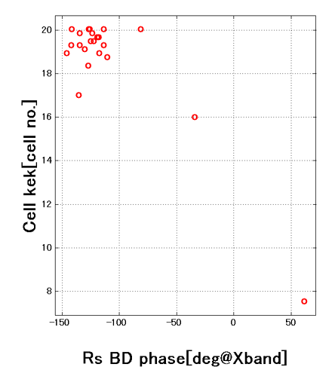
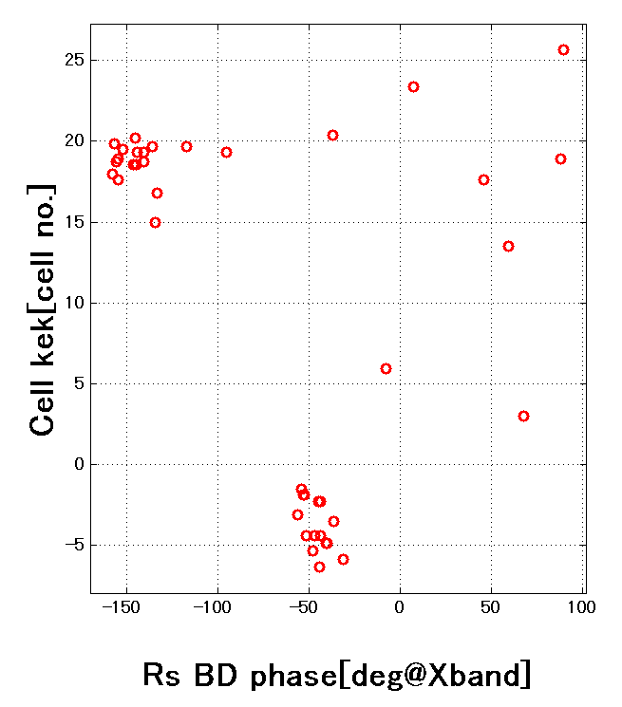

Hot spots localized in each cell
Run 27 at 100 MV/m
Run 31 at 110 MV/m
Only downstream
Both up and down

Slide 26
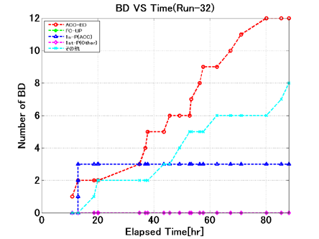
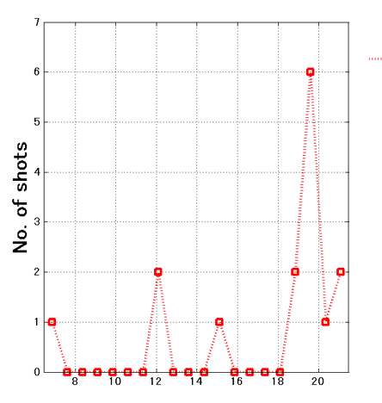
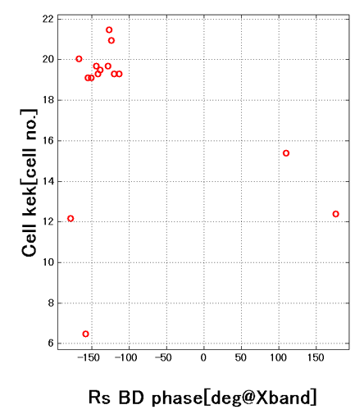
Run 32 run at 105 MV/m one of the sports disappeared
BDR = 4.2 X 10 ⁻⁶
A little decreased
due to disappearance of BD upstream?
Dominant
Gone?

Slide 27
TD24R05#2 Processing history
Non
BDR increase

Slide 28
Hot spots
Spots appeared after long-pulse operation.
They appear and disappear. The appearance may depend on field level, pulse width, etc.
We want to see how spots behave in further operation.
This is the first time for us to notice such hot spots, out of 5 prototype structures. Some cases known also at SLAC tests.
We need to identify the source of such spots and establish the technology to be away from them.

Slide 29
What to do for linear collider?
Evaluate performance and find mechanism
Just suppress it
  Material?
    Inclusion, foreign material, or crystal defects, ….
  Fabrication process?
    Clean environment
    Escape from possible dirty process, ….
  Processing in practice
    Any protocol?, gentle processing?,

Slide 30
Setups being prepared to study characteristics and mechanism of vacuum breakdowns in RF

Slide 31
Single-cell studies in preparation or in mind
HG2012 in April 2012
Explore basic research in a simple geometry
Center cell is such as the following
  Standard: KEK made – SLAC test
  Nominal: Heavily-damped
  Made of large-grain material
  Undamped but all-milled
  All milled quadrant type
  Choke-mode type
These are under preparation
Notes:
継続申請の3年間の目標 概略
基礎試験の立ち上げ
複合材料を含めた試験
TWでの可能性 見極め
放電頻度を決める放電のトリガーの理解
100MV/m超の加速ユニットの提案

Slide 32
Study with simple-geometries
Need to identify the breakdown mechanism in the relevant field level and including initial processing stage
Key issue toward stable high gradient operation for large-scale machine as CLIC
Studies with both prototype structures and simpler geometries are needed
KEK prepared the second test area (“Shield-B”) for the latter
Almost ready to start, just waiting for the klystron replacement

Slide 33
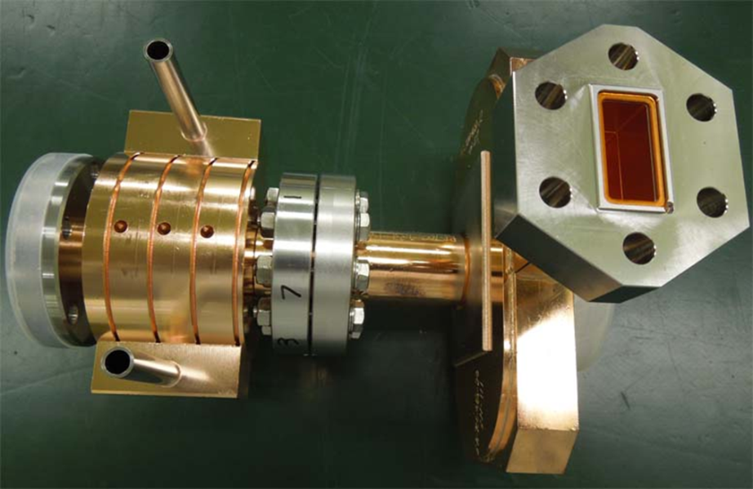
Strategy in mind
Proceed to evaluate
Damped cell
Damping aperture shape
Material
HIP, …..
Fabrication
Turning vs Milling
Heat treatments
Etching
Geometry
Quad
Choke
Start with a single-cell setup in nominal design and nominal fabrication method

Slide 34
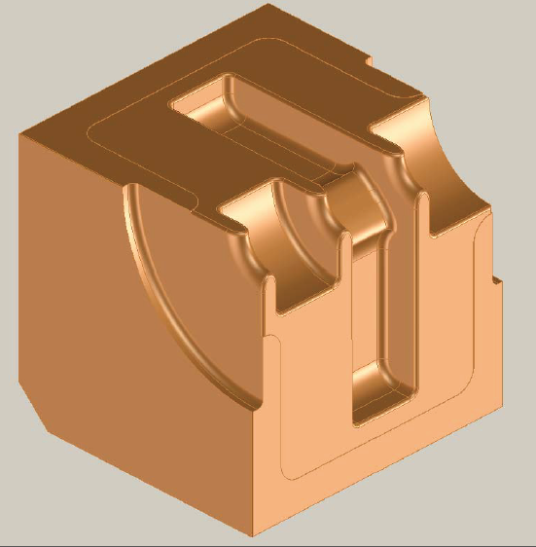
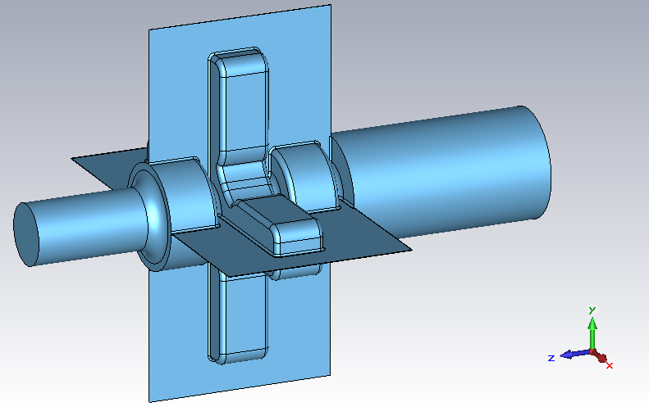
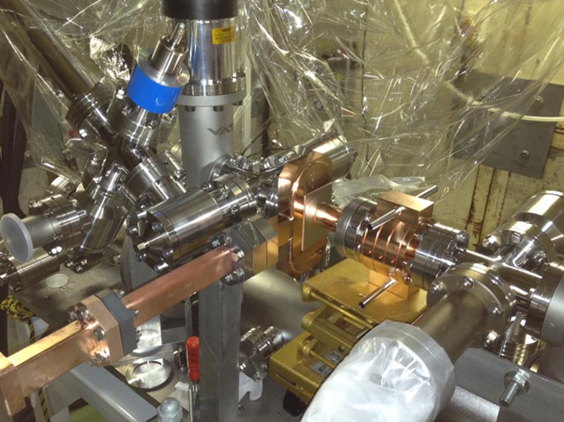
Quad with large Chamfer (R=400μm) with single-cell setup
0.1mm gap
between
facing planes
R=400μm
(Round Chamfer)
Shield-B
To understand why quad-type does not perform well under high gradient and possibly cure the problem!?

Slide 35
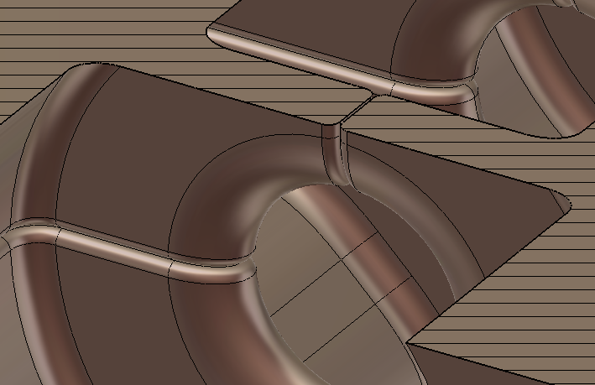
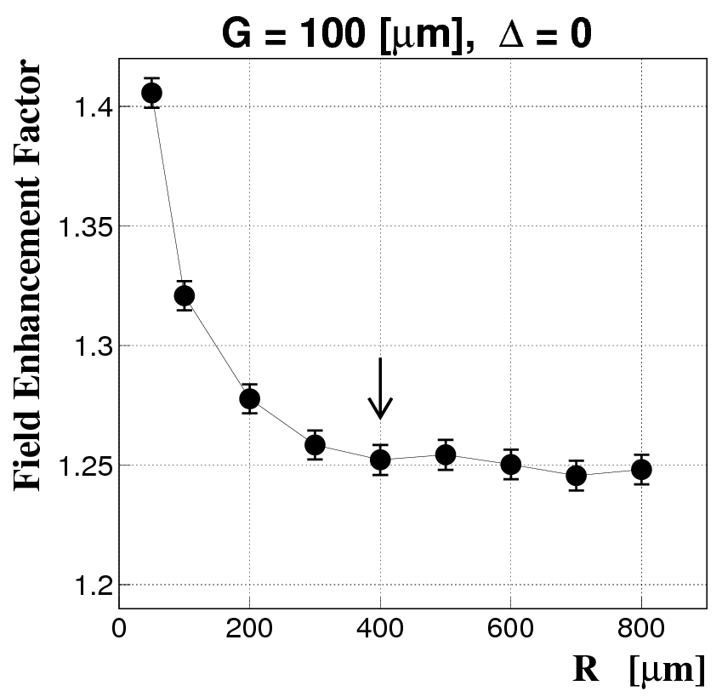
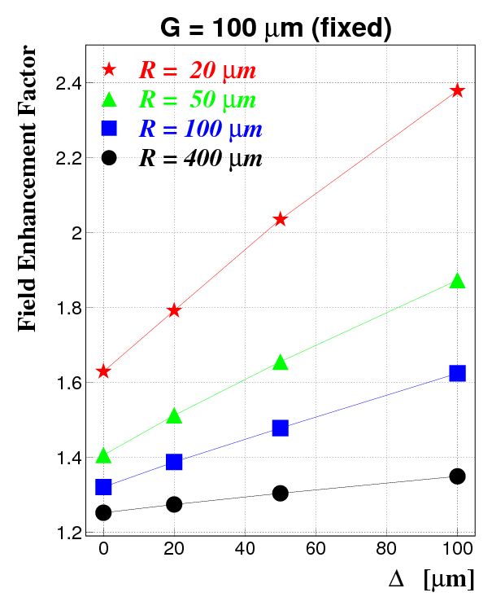
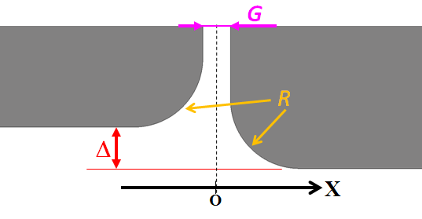
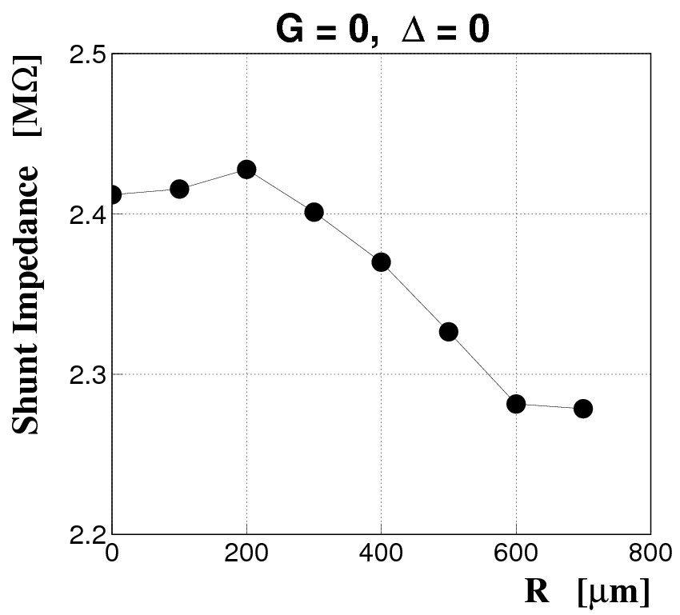
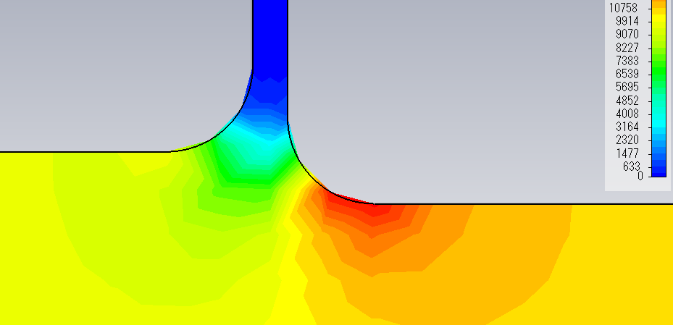
Field Enhancement due to the Concave Structure
Numerically Calculated by the Floating Random Walk Method
with Accuracies Better than 0.5%
For more details, see
T. Abe, “Study of Surface Field Enhancements due to Fine Structures,”
presented at the 8th Annual Meeting of Particle Accelerator Society of Japan, 2011 ,
Paper ID:TUPS086.
Copper
Vacuum
E.g.
|E| or |H|

Slide 36
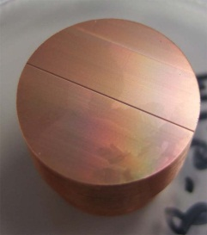
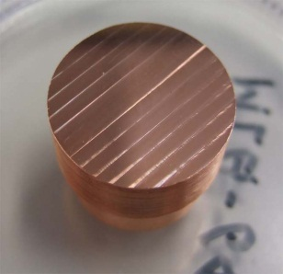
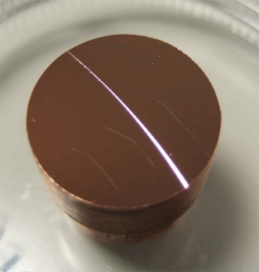
On-going copper surface evaluation
Takatomi
End mill
Ball End mill
Scratch by profilemeter
Turning lathe

Slide 37
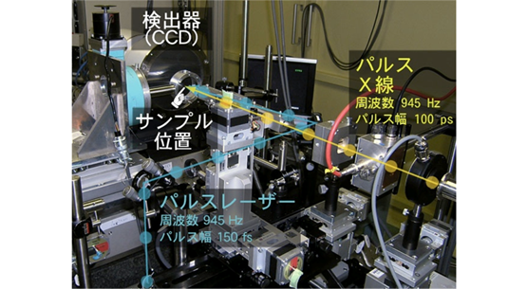
Heat deposit by laser and probed with SR light
SR X-ray
Drive laser

Slide 38
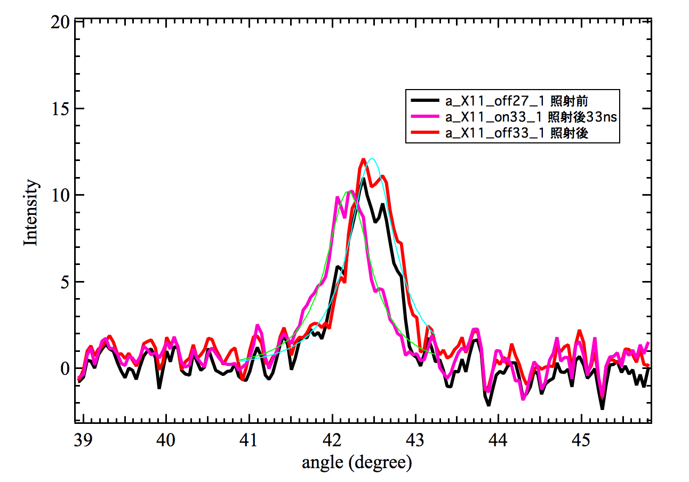
Crystal evaluation by PF X-ray
Zhang
Laser irradiation -> time dependent angle shift
of X-ray Bragg reflection (X. Zhang)
Shift corresponds to 300 degC
33nsec delay
After delay
Before

Slide 39
Parameters and next experiment
Experimental parameters
  Laser:
    YAG-Laser, pulse width 6~8ns,10Hz
    Power:0.5mJ/shot~10mJ/shot
  Probe beam diameter:
    x-ray: 60μm, laser:100 μm
  Time resolution:
    6ns
February experiment
  Evaluate relaxation time of material
  Irradiation limit for material to mechanically respond
  Crystal disruption limit versus power density and cycles of irradiation

Slide 40
Efforts to keep and develop
RF power source for Nextef

Slide 41
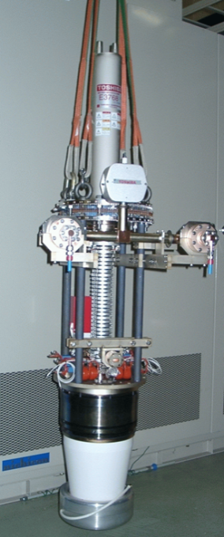
RF power sources
Modulator
  Invertor HV supply robust
  Thyratron needs intermittent adjustment or failure
PPM Klystrons
  Three have been used for nearly 10 years
  Pulse shortening exists
  But survives at 40MW level
  Failure in water circuits
  Not RF-origin failure
Driver for klystron
  Semiconductor amplifier

Slide 42
Effort to re-activate fabrication engineering lead by KEK

Slide 43

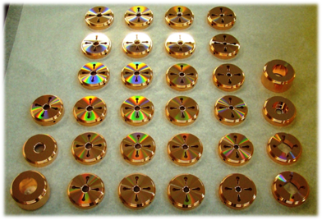
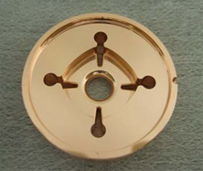
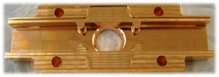
Continue fine parts fabrication +
Takatomi
DDS
12 GHz damped-detuned cells were made
By KEK
An example

Slide 44
Assembly at KEK and surroundings
An idea under consideration
High temperature processing
VAC baking eq.
Close Stainless steel vessel
and extract to clean room?

Slide 45
In conclusion

Slide 46
CERN/KEK collaboration has kept the base for KEK’s R&D toward high gradient
Application
Asian collaboration
KEK
Structure fabrication & test @Nextef
Tsinghua, IHEP
Structure design, fabrication & test
Medical
Industrial
Higgs, and others
US-Japan
SLAC/KEK
CERN/KEK collaboration
US-HG
CLIC
SLAC conducts structure fabrication, high power test & basic research
CERN supports for structure fabrication, high power test & system expansion

Slide 47
Summary
Six CLIC prototypes tested at Nextef
Breakdown rate proven in TD24#4 with CLIC pulse
TD24R05 found smoothly processed but hot spots emerged
Further studies in simple setup is almost ready
RF power sources are to be reinforced
CLIC high gradient collaboration keeps X-band study at KEK active
KEK further aggressive activities are foreseen after commissioning of SuperKEKB in early 2015

